Slide 1




React – The Functional Way
Marios Simou
Software Engineer
Portfolio: https://www.mariossimou.dev
marios.simou.184
Blog: https://www.blog.mariossimou.dev
@masimou2
MarioSimou
https://github.com/MarioSimou/react-the-functional-way-presentation

Slide 2
Agenda
Functional Programming (FP)
Introduction
Core Principles
Design Patterns
React
Introduction
JSX syntax
Components (class-based vs functional)
Communication between components
Stateful vs Stateless components
Side-effects – React Hooks
Functional React

Slide 3
Why should I bother learning FP?
What a good application means to you?
Good architecture - small, reusable units of code
Testing (unit, functional, integration, smoke, non-functional tests)
Can easily add new features
performance and acceptable limits
automation and deployment tools (CI/CD)
Functional programming helps you to mitigate most of these issues

Slide 4
Introduction to Functional Programming
Definition:
Opinionated way on how you structure your code
Aims to organize our code in functions
Solves the same problem as any other programming paradigm
Function:
Computer Science:
Accepts arguments and may return a result (routines/procedures/methods)
Allows multiple invocations and executions of the same logic
Calculus:
A relation between a dependent and independents variables – y = f(x)

Slide 5
Core Principles in FP – Pure Functions (1)
Pure vs Impure Functions
Pure: a function independent of side-effects
Impure: a function affected by side effects
Side-effects: any change in the code that is not controlled by the invoked function
Common Side Effects:
Sharing scope with other functions (e.g. global scope)
Any kind of Input/Output (I/O) (e.g. XHR calls, Filesystem access, DB request, DOM etc.)
Mutating objects received as arguments
Calling a function that is already impure

Slide 6
Core Principles in FP – Immutability (2)
const listFruits = (fruits = []) => {
while(fruits.length){
const fruit = fruits.pop()
// Product: orange, Product: banana, Product: apple
console.log('Product: ', fruit)
}
}
const fruits = ['apple', 'banana', 'orange’]
listFruits([...fruits]) // recreating the array
console.log(fruits.length) // 3
listFruits(fruits) // mutating the array
console.log(fruits.length) // 0
Once a variable is created, you cannot update it. The only option is to recreate it
If the variable is passed by reference, it’s recommended to recreate it when you pass it in a function
Methods that mutate variables should be avoided
e.g. push, pop, splice, shift, unshift and many others

Slide 7
Core Principles in FP – Higher Order Functions (3)
const getSum = (numbers = []) => {
let sum = 0
for(const number of numbers){
sum += number
}
return sum
}
const doSomethingWithArray = (arr, cb) => {
return cb(arr)
}
doSomethingWithArray([1,2,3,4], getSum) // 10
The language treats functions like any other data type. This means that it can be passed as a variable or even returned from a function

Slide 8
Design Patterns in FP – Closures (1)
const getCounter = () => {
let i = 0;
return () => ++i
}
const counter = getCounter()
counter() // 1
counter() // 2
counter() // 3
const newCounter = getCounter()
newCounter() // 1
newCounter() // 2
Any nested function that can access the scope of its parent function.
A function invocation usually creates a scope, meaning that nested functions can access the scope of their already invoked parent functions
“Private variable” in functional terms

Slide 9
Design Patterns in FP –Callbacks/Injection (2)
// error-first callback style
const processData = (e, data) => {
if(e){
return console.log('Error: ', e.message)
}
console.log('Processing data: ', data)
}
const fetchData = (number, delay, cb) => {
if(number < 10){
return setTimeout(cb, delay, new Error('The number is lower than 10’))
}
return setTimeout(cb, delay, null, {name: 'foo', email: 'foo@gmail.com'})
}
fetchData(20, 1000, processData) // Processing data: { name: 'foo', email: 'foo@gmail.com’ }
fetchData(5, 1000, processData) // Error: The number is lower than 10
We pass a function as an argument and we expect to execute at some point in time
May execute synchronously or asynchronously
Passing callbacks to a function is the traditional way for executing asynchronous code in JavaScript
This has changed with the introduction of constructs such as Promises and async/await, however, internally they still use callbacks

Slide 10
Design Patterns in FP – Partial Application and Currying (3)
const curry = fn => (...args) => {
if(args.length < fn.length){
return (...other) => curry(fn)(...args, ...other)
}
return fn(...args)
}
const addition = (a,b,c) => a + b + c
const curriedAddition = curry(addition)
curriedAddition(10,20,30) // 60
curriedAddition(10,20)(30) // 60 - Partial Application
curriedAddition(10)(20)(30) // 60 – Currying
const firstStep = curriedAddition(10)
const secondStep = firstStep(20)
secondStep(30) // 60
Rather than passing all the arguments of a function in a single call, we pass them incrementally
Currying is a subset of partial applications, where we pass a single argument at a time
Great way for creating a chain of scopes and preloading functions.

Slide 11
Design Patterns in FP – Declarative Programming (4)
const arr = [1,2,3,4,5]
// filtering
const filterElementsNotEqualOne = arr => {
const newArr = []
for(const num of arr){
if(num !== 1){
newArr.push(num)
}
}
return newArr
}
filterElementsNotEqualOne(arr) // [2,3,4,5]
arr.filter(num => num !== 1) // [2,3,4,5]
// mapping
const doupleArrayElements = arr => {
const newArr = []
for(const num of arr){
newArr.push(num * 2)
}
return newArr
}
doupleArrayElements(arr) // [2,4,6,8,10]
arr.map(num => num * 2) // [2,4,6,8,10]
Focus on the result of a code snippet rather than the implementation details
FP provides utility functions to work with data structures with a declarative way

Slide 12
Design Patterns in FP – Others (5)
Recursion
A function call itself again and again until it meets a condition
Thunks/Lazy Loading
Delays the evaluation of an expression until its value is needed
Memoization
The technique of introducing a storage unit, which stores values that have already been calculated
Pipelining
Executes a sequence of functions, with each function’s output used as the input of the following one. It is moved from left to right.
Composing
Similar to pipeline with the exception that it is moved from right to left
Monads
Functors

Slide 13
Pros and Cons of FP
Advantages:
Easy to maintain and preserve over time
The signature of a function provides all the information a developer needs to understand the logic
Testing becomes much easier
No needs for extended stubbing, mocking since you are writing code with dependency injection in mind (DI)
Less buggy code
Each unit of your application works on its own, without relying on outside effects
Rise of multithread environments since threads are decoupled
Disadvantages:
Steeper learning curve
It includes concepts that developers are not familiar with and may require a bit of time until they grasp them
May introduce performance issues
Immutability suggests the recreation of variables, which also includes more CPU and memory (immutable data structures)
Less intuitive compared to other programming paradigms
A developer is more likely to solve a problem with an OOP rather than a FP approach

Slide 14
Introduction to React
According to its official website, React is “A JavaScript library for building user interfaces”
Features:
Component-Based
The basic unit of React is a component, which is a container of JSX/JavaScript code
The idea is to split the UI into small, reusable components and then combine them to create the whole application
JSX syntax
HTML-like syntax used to create components
Its not necessary but it makes development more efficient and removes complexity
Declarative
React abstracts away the details on managing the DOM, allowing us to focus on building the UI
Listens on state changes and reacts to them

Slide 15
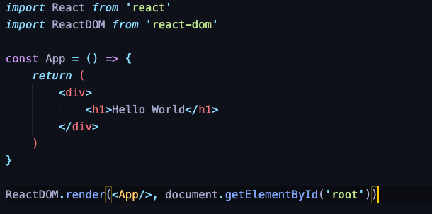
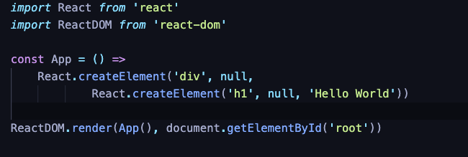
How it looks like?
JSX Syntax
Plain React Syntax

Slide 16
How it works?
Traditional approach:
Access the DOM (Document Object Model) and update the attributes of an element
React approach:
React creates a virtual DOM in the background, which keeps track of the changes within the components
It uses an efficient algorithm to compare the actual DOM with the Virtual DOM (diffing)
When there is a change in the state of a component it updates the actual DOM, but only for those nodes related to the change.
Improves performance since it avoids to re-render and re-paint the UI unnecessarily

Slide 17
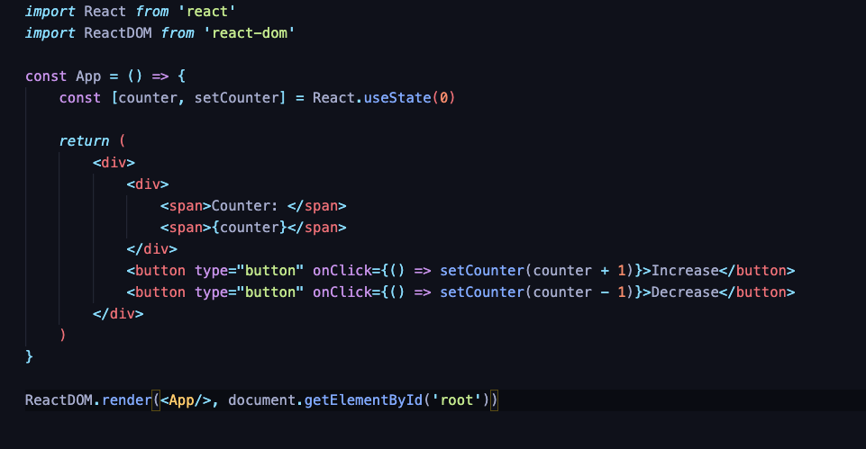
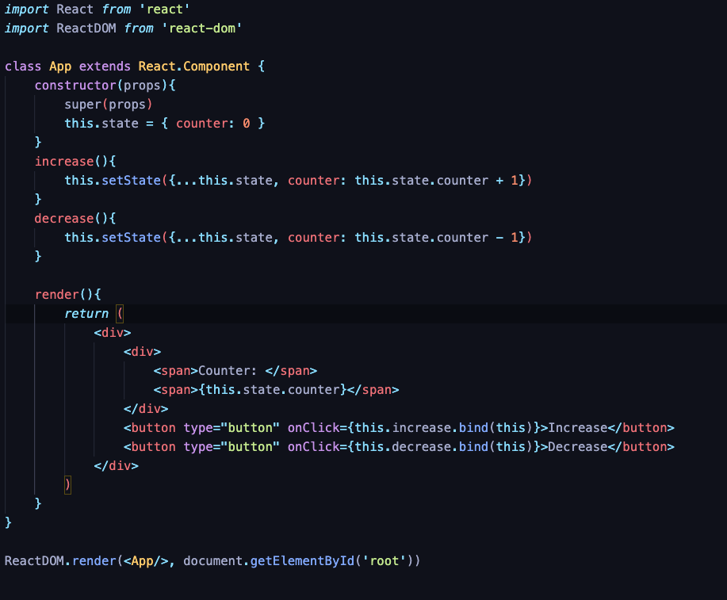
Class-based vs Functional Components
Functional Component
Class-based Component
A component is a function that returns JSX code
Class-based: initialized using ES6 class keyword
Functional: initialized using a function declaration
Prior version 16.8, using a class-based component was the only way to handle state
From version 16.8 and afterwards, React hooks allow to Functional components to manage state

Slide 18
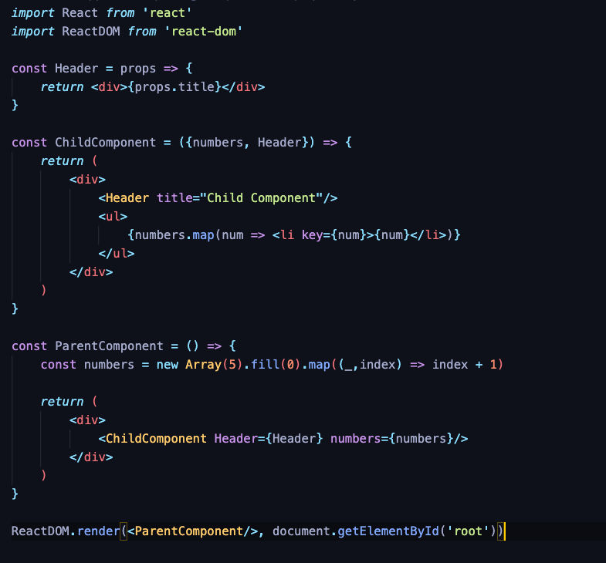
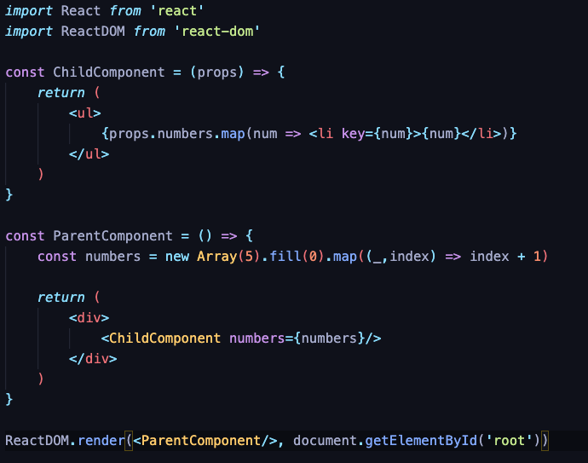
Communicating Between Components
A component accepts arguments which are known as properties (props)
Properties can only be passed from a parent to a child component, not vice-versa
Properties can either be plain objects or functions
The idiomatic way is to pass new props when you want to re-render the component. Not to update them (immutability)
Components that accept other Components/Functions as inputs are known as Higher Order Components (HOC)

Slide 19
Stateful vs Stateless Components
Stateless Component
A stateful component is any component that manages state
State can either be external or local
State can be passed down as a property to child components
State cannot be shared
A stateless component is any component independent of state (pure)
Also known as Containers vs Presentational components
Stateful Component

Slide 20

Wait a minute…
Show me how can I set an external state!
Side-effects

Slide 21
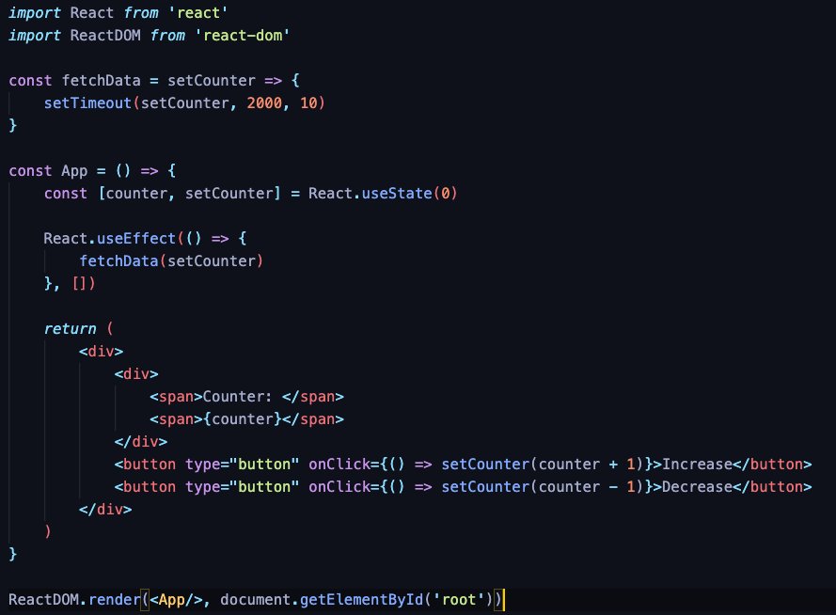
Side-Effects - React Hooks
We use React hooks to handle side-effects
React hooks is a bridge between a stateful and a functional world
useState
useEffect
useContext
useReducer
useMemo
useRef
etc.
So, App component won’t be pure anymore

Slide 22
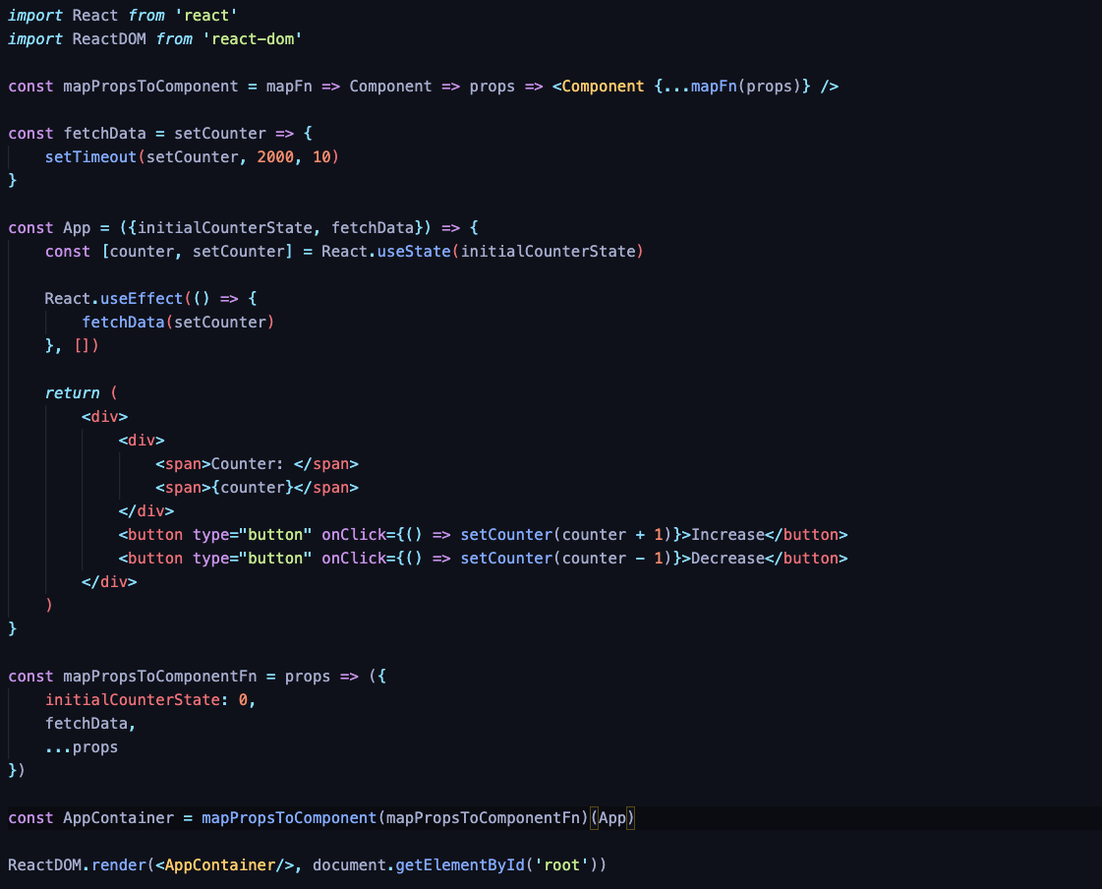

Slide 23
Functional React
Components are Functions
Closures
Pure/Impure Functions
A stateless component is pure
Callbacks
React Hooks
Properties
Immutability
Currying/Partial Application
HOC
Higher Order Components
Declarative Programming
…

Slide 24
Where you should look next?

Slide 25
Things you should take with you

Slide 26
Thank you for listening!!!
Portfolio: https://www.mariossimou.dev
marios.simou.184
Blog: https://www.blog.mariossimou.dev
@masimou2
MarioSimou
https://github.com/MarioSimou/react-the-functional-way-presentation

